Slide 1
Chess Neural Network AI
Team Members:
1. Nikhil Thapa
2. Bandu Sakhare
3. Prajwal Jadhav
4. Rohan Mandhare
Guided by:
Prof. Shwetkranti Taware

Slide 2
Agenda
Aim
Motivation
Objectives
Proposed System
S/W development process Model
Responsibilities of Classes and Objects identified in the project
State Transition diagram
Interface and functional dependencies between modules
Mathematical Model
Algorithms
Project Implementation
Conclusion
References

Slide 3
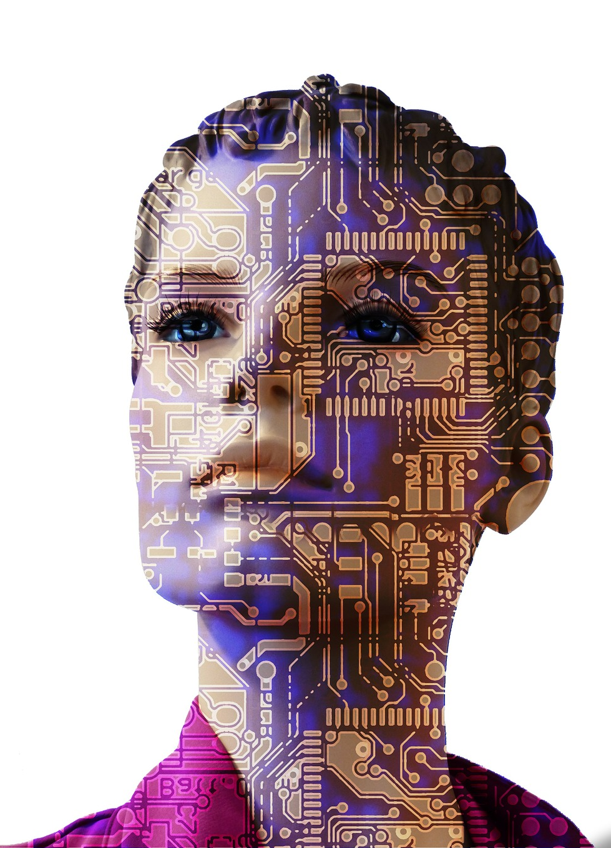
Aim
Aim: To develop a program/software that can train Human Mind to increase his/her IQ Level
Subtitle : To search the position deeply enough beyond the abilities of humans. To be able to help Professional Players to improve their game even further.

Slide 4
Motivation
The use of Computers is increasing rapidly in the field of Chess to scan the most difficult problems using sophisticated algorithms.
Computers have played an important and vital role in increasing the strength of a chess player.
Advanced Technology improvements in chess will completely change the way we look into the game of Chess.
With more than 10⁸⁰ moves possible in chess, only one is the best move. The job of the AI is to find that move.

Slide 5
Objectives
To create an AI to scan millions of positions to find the best move.
To create an AI that can self-adjust according to Human Thinking. The more games we feed, the better AI adjusts itself to Human Thinking.
To help a player to increase his mental strength or IQ level.
Professionals can improve their game by analyzing mistakes and blunders.
To change the game of chess of how it was observed a few years back.

Slide 6
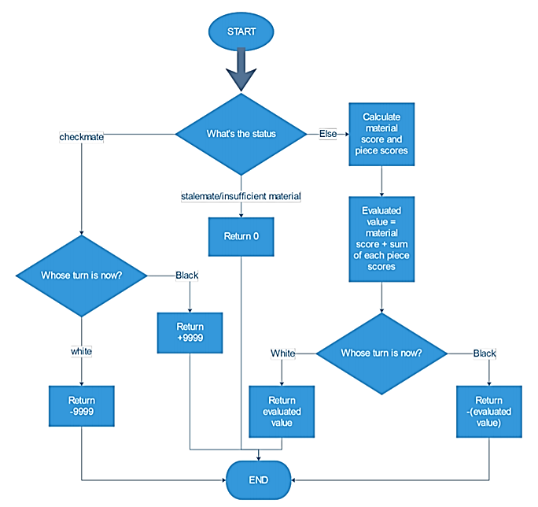
Proposed System
Evaluation Function
Evaluation Function calculates the material value and piece placement score (max scope).
It then returns the value to the evaluated position.

Slide 7
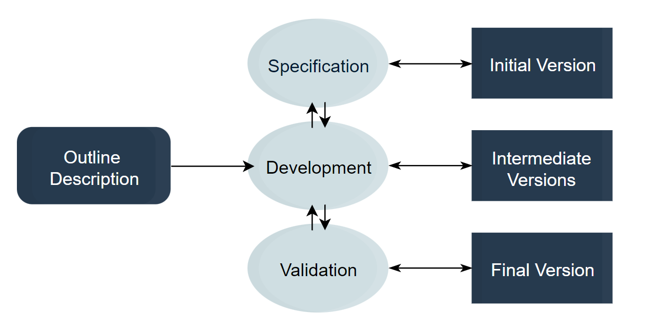
S/W development process model used
Incremental Model

Slide 8
Responsibilities of Classes and Objects identified in the project
No. | Class | Responsibility
1 | Spot | A spot represents one block of the 8×8 grid and an optional piece.
2 | Piece | The basic building block of the system, every piece will be placed on a spot. Piece class is an abstract class. The extended classes (Pawn, King, Queen, Rook, Knight, Bishop) implements the abstracted operations.
3 | Board | Board is an 8×8 set of boxes containing all active chess pieces. The Board class is used to represent a chess board.
4 | Player | Player class represents one of the participants playing the game. It can be a human or a computer
5 | Move | Represents a game move, containing the starting and ending spot. The move class will also keep track of the player who made the move.
6 | Game | This class controls the flow of a game. It keeps track of all the game moves, which player has the current turn, and the final result of the game.

Slide 9
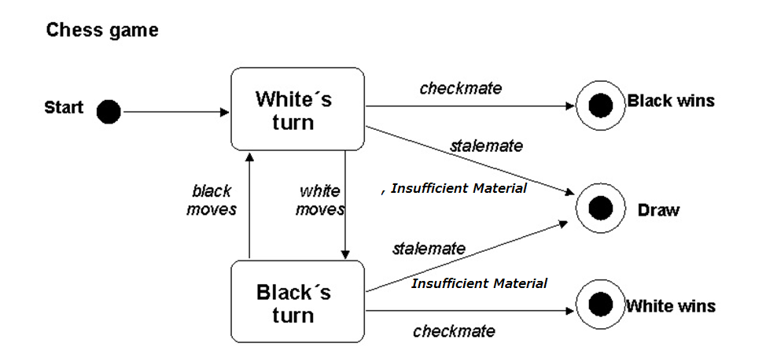
State Transition Diagram :

Slide 10
Interface and Functional Dependencies between Modules
User Interface-
The GUI provides various information to the user.
User – Playing move as an input
Analyze – Using Neural network calculations for best move is done and AI analyze the best move.
Display – Piece Movement and Possible move.
The application provides the following information:
Taking Player game data from internet .
Input by user as a best move, AI recommended best moves as per moves file selected by us.

Slide 11
Dependancy
Sr No. | Dependancy | Version
1. | C# | 10.0
2. | Unity | 2021.2.0
3. | Tensorflow Python | 3.10.0
4. | PGN Viewer | GPL (3.0 License)

Slide 12
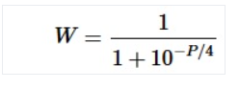
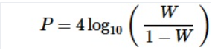
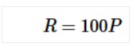
Mathematical Model
For each material configuration, pawn advantage is computed to a fraction of 1/100 of a point.
After analysing 100 Million games, an approximate relationship between Winning probability & Pawn advantage is given:
W = Winning Probability
R = Expected Rating Difference b/w Winner & Loser
= (Winner Rating) – (Loser Rating)
P = Pawn Advantage

Slide 13
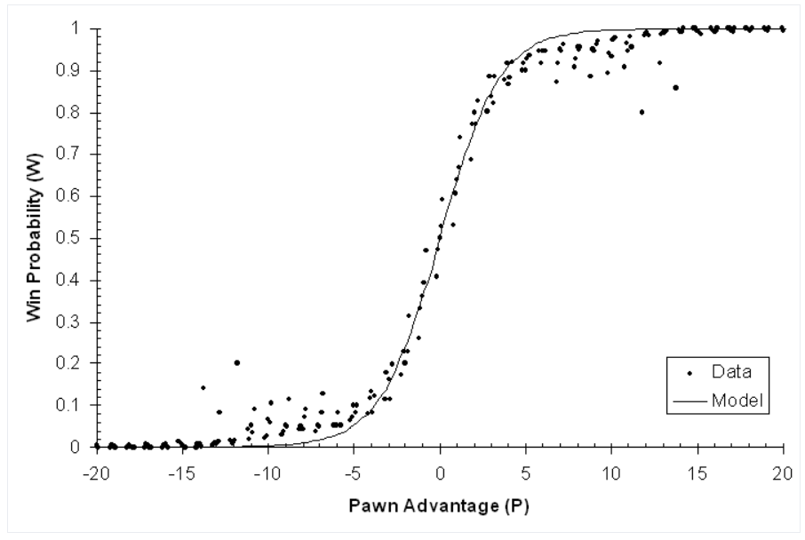
Mathematical Model

Slide 14
Algorithms
Pure Minimax Search
+ Alpha-beta Pruning
Move Ordering
Naïve Pattern Searching
Greedy Algorithm
Zobrist Hashing

Slide 15
Algorithms
Pure Minimax Search is based on a recursive algorithm for choosing the next move.
A value is associated with each position of the game is calculated by the Evaluation Function.
According to the minimax algorithm, a tree of all possible moves is generated until the depth is defined.
At the depth, millions of positions are scanned and each position is given an evaluation.
Based on the final evaluation, the evaluation of the upper node is defined.
The Upper node is given a number based on the best possible reply of the opponent and the best possible choice.

Slide 16
Algorithms
Pure Minimax Search
6
9
-2
4
-6
0
-8
7
-9
4
2
6

Slide 17
Algorithms
+Alpha-beta Pruning is an optimization that reduces the search and the scan time.
6
-2
4
-6
0
-8
4
2
6

Slide 18
Algorithms
Naïve Pattern Searching is used for searching the position of pieces from the Forsyth-Edwards Notation (FEN) string
Zobrist Hashing is used to generate the FEN String and it is stored in the transposition table. If the same position is encountered again, we simply retrieve the stored value from the transposition table.
Move Ordering is an optimization to eliminate the searching of moves with the same positions that occur through transpositions.
Greedy Algorithm is used to compare the evaluation of all the next possible moves and it gives the upper node a number based on the best possible choice or best possible reply.

Slide 19
Project Implementation
Chess Neural Network AI

Slide 20
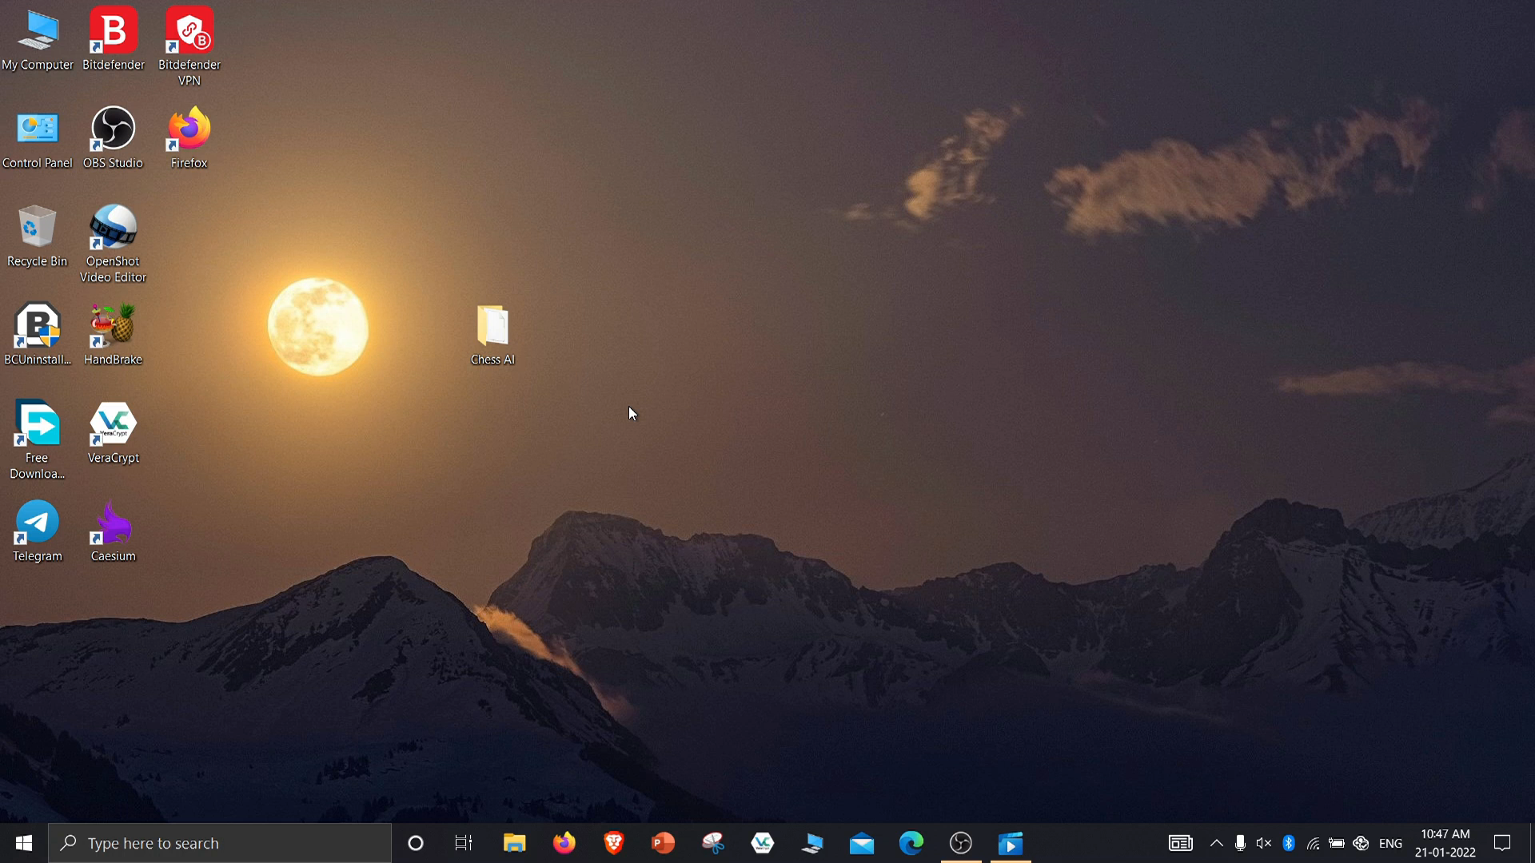

Slide 21
Conclusion
Chess is a game with infinite possibilities. And in some positions, it becomes almost impossible for Humans to calculate what’s the current scenario. With the growth of technology & Artificial Intelligence, computers and AI can do extremely difficult calculations that can unlock the ultimate beauty of this Game. Chess Neural Network AI can scan millions of positions to generate the best variation out of millions of possibilities. It can calculate beyond the abilities of a human.

Slide 22
References
[1] Chess training system digitalization process analysis, Mikhailova, I. V. and Makhov A. S,2021
[2] Laurence Fausett, “Fundamentals of Neural Networks Architectures, Algorithms, and Applications”, Dorling Kindersley Pvt. Ltd., South Asia, 2018
[3] Alexandru Godescu, “An information theoretic analysis of decision in computer chess” ETH Zurich December 13, 2011
[4] Diwas Sharma, Udit Kr. Chakraborty, Artificial Neural Network based adaptive chess playing machine. International Journal of Advance Research in Computer Science, Vol 4 no. 4, March-April 2013.
[5] Chess Agent Prediction using Neural Network , John Dalloul , Mark Bechthold , Stanford University,2017.
[6] Chess AI : Completing Paradigms for Machine Learning , Shiva Maharaj, Nick Polson, Alex Turk.2019.

Slide 23
References
[7] Aligning Superhuman AI with Human Behaviour: Chess as a Model System, Reid McIlroy-Young, Siddhartha Sen, Jon Michael Kleinberg, 2020
[8] From Chess and Atari to StarCraft and Beyond: How Game AI is Driving the World of AI, Sebastian Risi, Mike Preuss, 2020
[9] Chess AI: Competing Paradigms for Machine Intelligence, Shiva Maharaj, Nick Polson, Alex Turk,2021
[10] Mastering Atari, Go, chess and shogi by planning with a learned model, 2020.
[11] Segler, M. H., Preuss, M. & Waller, M. P. Planning chemical syntheses with deep neural networks and symbolic AI. Nature 555, 604–610 (2018).

